Slide 1
BASIC BOW SET UP AND TUNING
Carol Bladen March 2022

Slide 2
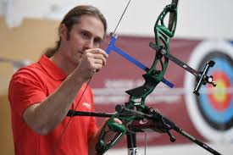
WHAT IS BOW TUNING?
WHAT IS THE PURPOSE OF TUNING A BOW
WHY DOES IT MATTER
WHAT ARE THE OBJECTIVES

Slide 3
BOW TUNING IS:
SETTING UP THE BOW TO BE EFFICIENT
MAKING THE SET UP FORGIVING
GETTING THE ARROW GROUP AS SMALL AS POSSIBLE
FOR THAT INDIVIDUAL ARCHER
FOR THEIR SKILL LEVEL
FOR THEIR EQUIPMENT LEVEL

Slide 4
WHAT KIT DO WE NEED?
Archer, bow and arrows
Target
Arrow spine chart
Brace height gauge, limb alignment gauges, bow weight scales
Allen keys, screwdriver, bow stringer

Slide 5
THE MOST IMPORTANT EQUIPMENT?

Slide 6
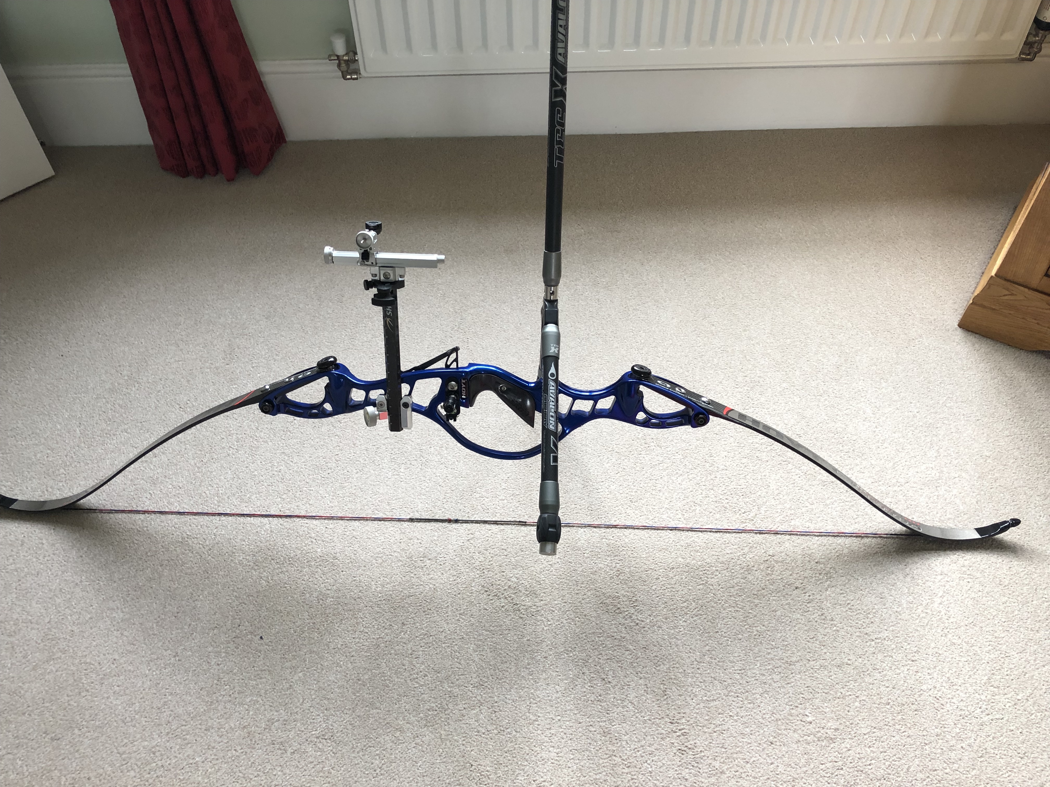
STEP ONE
INSPECT THE EQUIPMENT
CHECK THE CONDITION OF THE BOW, STRING, SERVING, REST, BUTTON CLICKER
CHECK THE ARROW SPINE-DOES IT MATCH THE BOW?
CHECK THE STABILISERS
CHECK THE LIMB BOLTS, SIGHT AND LIMBS (ARE THEY STRAIGHT?)

Slide 7
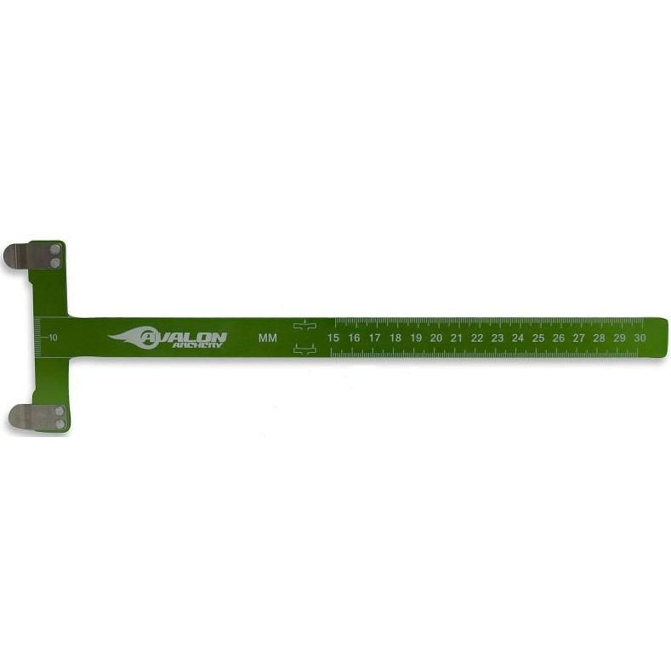
MEASUREMENTS
WHAT MEASUREMENTS ARE YOU GOING TO MAKE
AND RECORD!!!!

Slide 8
MEASUREMENTS 1
THERE ARE A NUMBER OF THINGS TO RECORD:
BOW:
BOW MAKE
BOW LENGTH
DRAW WEIGHT
BRACE HEIGHT
TILLER
NOCKING POINT HEIGHT
REST POSITION
CLICKER POSITION
TYPE AND DISTRIBUTION OF STABILISERS
STRING LENGTH, MATERIAL AND NUMBER OF STRANDS,

Slide 9
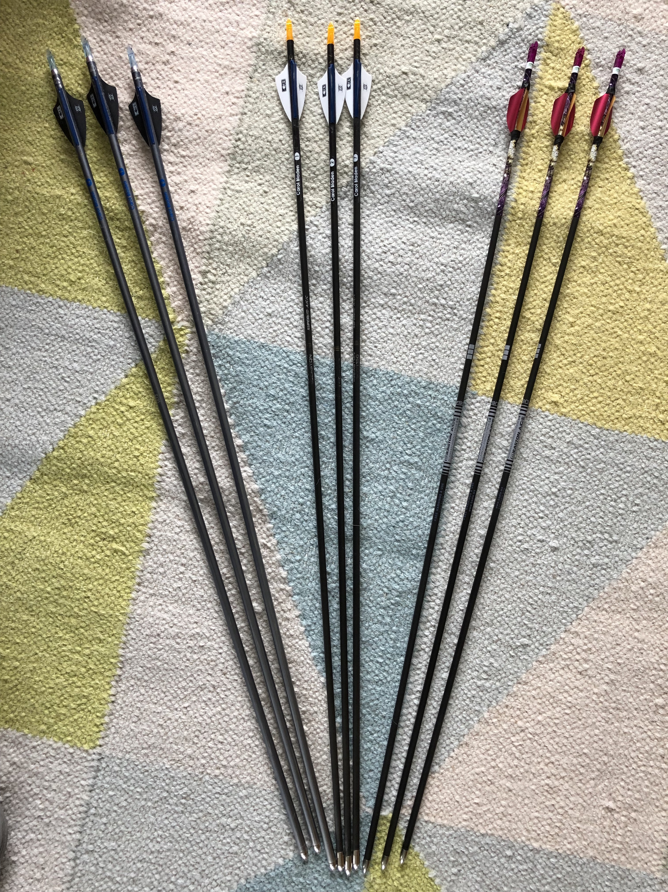
MEASUREMENTS 2
ARROWS:
MAKE AND TYPE
SPINE
LENGTH
NOCK TYPE
FLETCHINGS
POINTS-TYPE AND WEIGHT

Slide 10
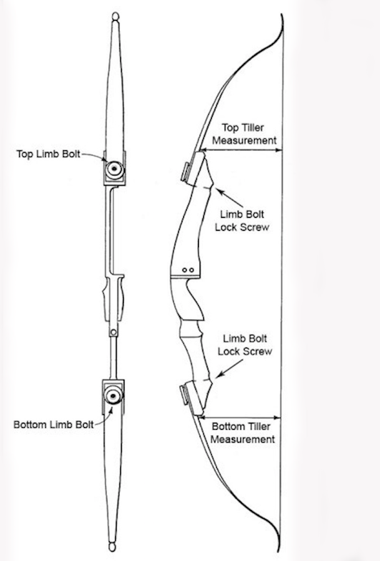
TILLER 1
HOW DO WE MEASURE THE TILLER?
IT IS THE DIFFERENCE IN THE DISTANCE OF THE TOP LIMB TO THE STRING AND THE DISTANCE OF THE BOTTOM LIMB TO THE STRING
ON THE DIAGRAM:
TILLER = (TOP-BOTTOM MEASUREMENTS)
USUALLY THE TILLER IS APPROX 3-4MM BUT WILL VARY

Slide 11
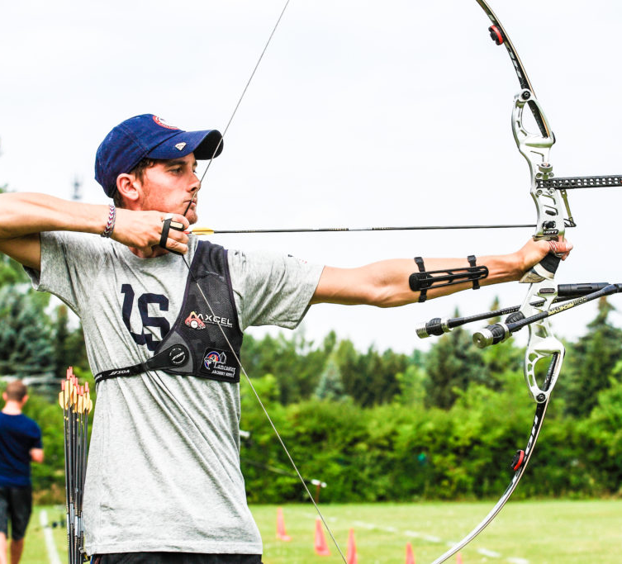
TILLER 2
WHAT IS THE BOW TILLER?
HOW DO YOU MEASURE IT?
TILLER IS THE RELATIONSHIP BETWEEN THE STIFFNESS OF THE 2 LIMBS
THE BOTTOM LIMB IS SLIGHTLY STIFFER THAN THE TOP LIMB
IT IS RELATED TO THE POSITION OF THE BOW HAND ON THE HANDLE
THE ARROW WILL LIE APPROX 5CM ABOVE THIS POINT AT FULL DRAW

Slide 12
TILLER 3
THE BOW MAKER SETS THE LIMBS SO THAT THE TOP LIMB IS SLIGHTLY FURTHER AWAY FROM THE STRING THAN THE BOTTOM LIMB AND THE BOTTOM LIMB IS SLIGHTLY STIFFER
THIS ALLOWS THE FORCES ON THE ARROW TO BE EQUALISED FROM THE TWO LIMBS
THE TWO LIMBS ARE DRAWN RELATIVE TO ONE POINT, (THE BOW HAND) BUT THE FORCES ARE DIRECTED INTO THE ARROW AT ANOTHER POINT

Slide 13
CHANGING THE TILLER
THIS IS DONE BY MOVING THE LIMB BOLTS IN OR OUT, TO SET THE MEASUREMENTS TO THE DESIRED TILLER
BUT:
THIS MAY CHANGE THE DRAW WEIGHT!!
WHATEVER CHANGE YOU MAKE TO THE TOP LIMB BOLT YOU DO THE OPPOSITE ON THE BOTTOM LIMB BOLT
FOR EXAMPLE, 1 FULL TURN INWARDS ON THE TOP NEEDS 1 FULL TURN OUTWARDS ON THE BOTTOM

Slide 14
BRACING HEIGHT
WHAT IS THE BRACING HEIGHT?
WHAT DOES IT MEAN?
HOW DO YOU MEASURE IT?

Slide 15
BRACING HEIGHT
THE DISTANCE FROM THE BOW TO THE STRING
BUT WHERE ON THE BOW?
THERE ARE DIFFERING OPINIONS
MOST PEOPLE MEASURE TO THE THROAT OF THE HANDLE
OR TO THE CENTRE OF THE PRESSURE BUTTON

Slide 16
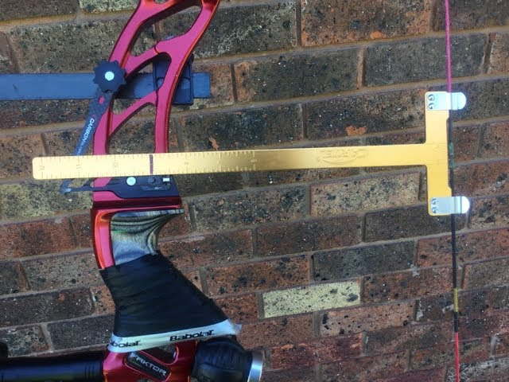
WHERE TO MEASURE?
AT RIGHT ANGLES TO STRING
TO CENTRE OF BUTTON?
TO THROAT OF BOW?
TO FIXED POINT ON BOW?

Slide 17
BRACING HEIGHT
WHAT SHOULD IT BE
CHECK MANUFACTURERS INFORMATION
VARIES DEPENDING ON THE BOW AND THE BOW LENGTH
CHECK THE TABLE FOR A GUIDE
THE GUIDES GIVE A RANGE FOR THAT BOW

Slide 18
WHAT IS THE OPTIMUM BRACE HEIGHT?
TWO FACTORS:
1. THE SOUND-THE STRING SHOULD SOUND QUIET WHEN SHOT
2 EYEBALLING THE BOW AND STRING-DOES IT LOOK ABOUT RIGHT?
THIS IS THE ART OF TUNING!
MOST BOWS SHOOT BETTER WITH THE BH AT THE UPPER END OF THE RECCOMMENDED RANGE

Slide 19
BRACING HEIGHT
WORD OF WARNING:
THE BRACING HEIGHT WILL NOT STAY THE SAME
ONCE A FEW ARROWS ARE SHOT, THE STRING MAY STRETCH AND CHANGE THE BH
WORTH RECHECKING!!
MAKE SURE YOU RECORD IT!!

Slide 20
NEXT-THE NOCKING POINT
SETTING NOCKING POINT
WHERE DO YOU DECIDE TO SET THE NP?
THERE IS A RELATIONSHIP BETWEEN TILLER AND NP HEIGHT
MANY PEOPLE SAY TO SET THE NP HEIGHT AT THE SAME DISTANCE ABOVE SQUARE AS THE TILLER (AS A START)

Slide 21
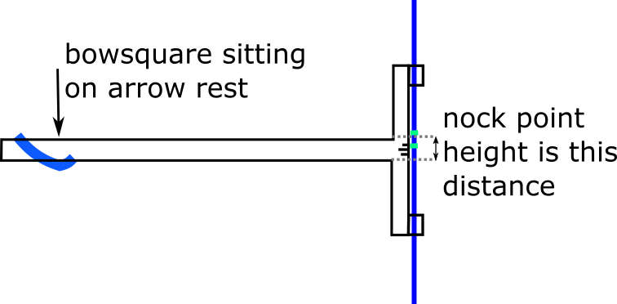
NOCKING POINT
MOST PEOPLE RECOMMEND 1/8 TO 3/16 INCHES ABOVE SQUARE
THAT’S 3 TO 5 MM FOR METRIC FOLK!
WHY IS IT ABOVE SQUARE?
YOU CAN ATTACH A TEMPORARY NP WHILE TUNING AND ATTACH A PERMANENT ONE LATER

Slide 22
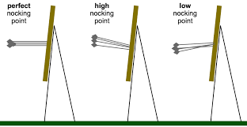
NOCKING POINT
TO SET THE NOCKING POINT 1:
WITH A SUITABLE BRACING HEIGHT, SHOOT ARROWS AT 20YRDS
OBSERVE THE ANGLE AT WHICH THE ARROWS LAND
IF HORIZONTAL NP IS GOOD
IF POINTS LOWER THAN NOCK THE NP IS TOO HIGH
IF POINTS ARE HIGHER THAN NOCK THE NP IS TOO LOW

Slide 23
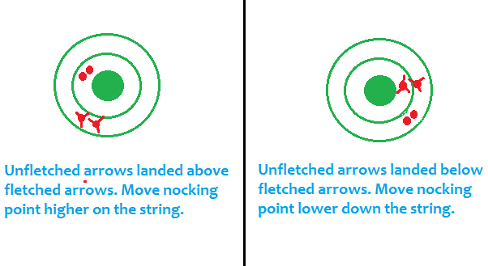
NOCKING POINT
TO SET NP 2:
SHOOTING FLETCHED AND BARE SHAFT
SHOOT 3 FLETCHED AND 3 UNFLETCHED
IF THE UNFLETCHED ARROWS LOWER THAN FLETCHED THE NOCKING POINT IS TOO HIGH
IF THE UNFLETCHED ARROWS ARE HIGH THEN THE NOCK POINT IS TOO LOW

Slide 24
ARROW REST AND PRESSURE BUTTON
THE REST MUST BE FAR ENOUGH BELOW THE BUTTON TO ALLOW THE BUTTON TO MOVE FREELY
THE BUTTON SHOULD BE SLIGHTLY ABOVE THE CENTRE LINE OF THE ARROW TO ALLOW CLEARANCE AND REDUCE THE TENDENCY FOR THE ARROW TO RIDE UP ON THE BUTTON
ARROW CLEARANCE IS KEY!

Slide 25
BUTTON AND REST

Slide 26
SETTING THE BUTTON
WHAT ARE THE 2 POSSIBLE ADJUSTMENTS?
ANSWER:
1. SCREWING THE WHOLE UNIT IN OR OUT
2. INCREASING OR DECREASING SPRING TENSION

Slide 27
CENTRE SHOT
WHAT IS CENTRE SHOT?
HOW IS IT SET?
HOW IS IT CHANGED?

Slide 28
CENTRE SHOT
FOR RECURVE:
1.PLACE ARROW ON STRING
2. LINE UP STRING WITH LIMB CENTRES
3. LOOK ALONG ARROW WITH CENTRE LINE IN YOUR EYE
4. IS THE ARROW TO THE LEFT OR THE RIGHT OF THE STRING?
5. IDEALLY IT SHOULD BE SLIGHTLY LEFT (APPROX ½ THE SHAFT?)
6. ADJUST BY SCREWING THE WHOLE BUTTON IN OR OUT

Slide 29
BUTTON SPRING TENSION
WHAT DOES THE SPRING DO IN A BUTTON?
IT PUSHES THE ARROW OUT FROM THE BOW (ALLOWING CLEARANCE AND THE ARCHER’S PARADOX TO OCCUR CORRECTLY)
WHAT ELSE IS IMPORTANT?
ARROW SPINE-THE ARROWS MUST BE MATCHED TO THE BOW

Slide 30
TUNING THE BUTTON
HOW DO WE DO THIS?
BARE SHAFT TUNING
WALKBACK

Slide 31
BUTTON TUNING-BARESHAFT
ANALYSING THE POSITION OF BARE SHAFTS RELATIVE TO FLETCHED ARROWS
TRYING TO BRING THE BARESHAFTS CLOSER TO THE FLETCHED GROUP
MANY RECURVE SHOOTERS FIND THE BARESHAFT SHOOTS SLIGHTLY LOW AND SLIGHTLY LEFT OF THE FLETCHED GROUP, THOUGH STILL CLOSE

Slide 32
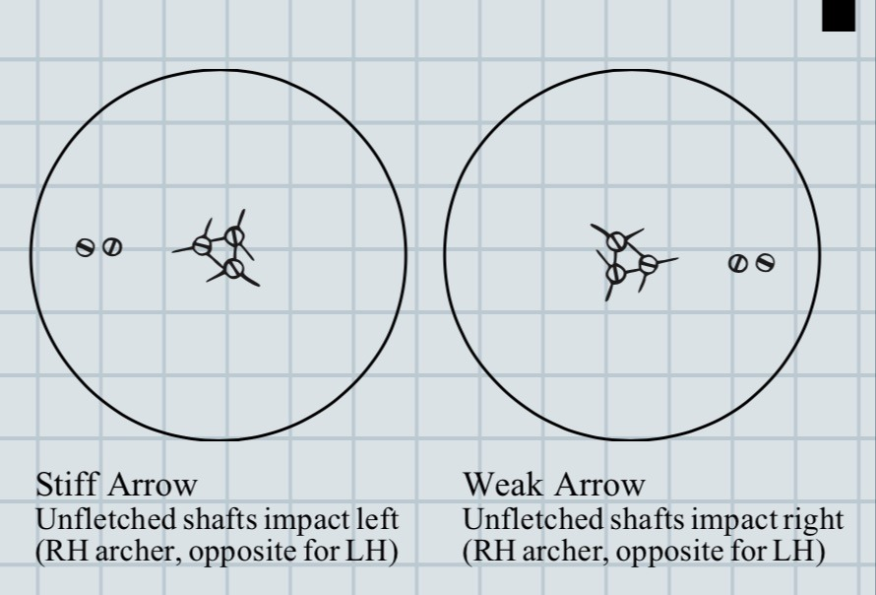
BUTTON BARESHAFT TUNING
RESULTS:
IF THE BARESHAFTS ARE LEFT THIS IMPLIES THE ARROWS ARE STIFF, AND THE BUTTON SPRING TENSION IS TOO HIGH
IF THE BARESHAFTS LAND TO THE RIGHT, THE ARROWS ARE WEAK AND THE SPRING TENSION CAN BE INCREASED
FOR RH SHOOTER

Slide 33
BUTTON TUNING
WHAT IS THE MOST IMPORTANT PART OF THIS EXERCISE?
MAKE NOTES!
HOW MUCH INCREASE OR DECREASE TO SPRING TENSION WAS MADE
WHAT EFFECT DOES THIS HAVE ON THE BARESHAFT POSITION

Slide 34
WALKBACK TUNING
A MORE SOPHISTICATED WAY OF BUTTON SPRING TENSION ADJUSTMENT
HOW DO WE DO THIS?
NEED SPACE, QUIET AREA, AWAY FROM OTHER SHOOTERS FOR SAFETY

Slide 35
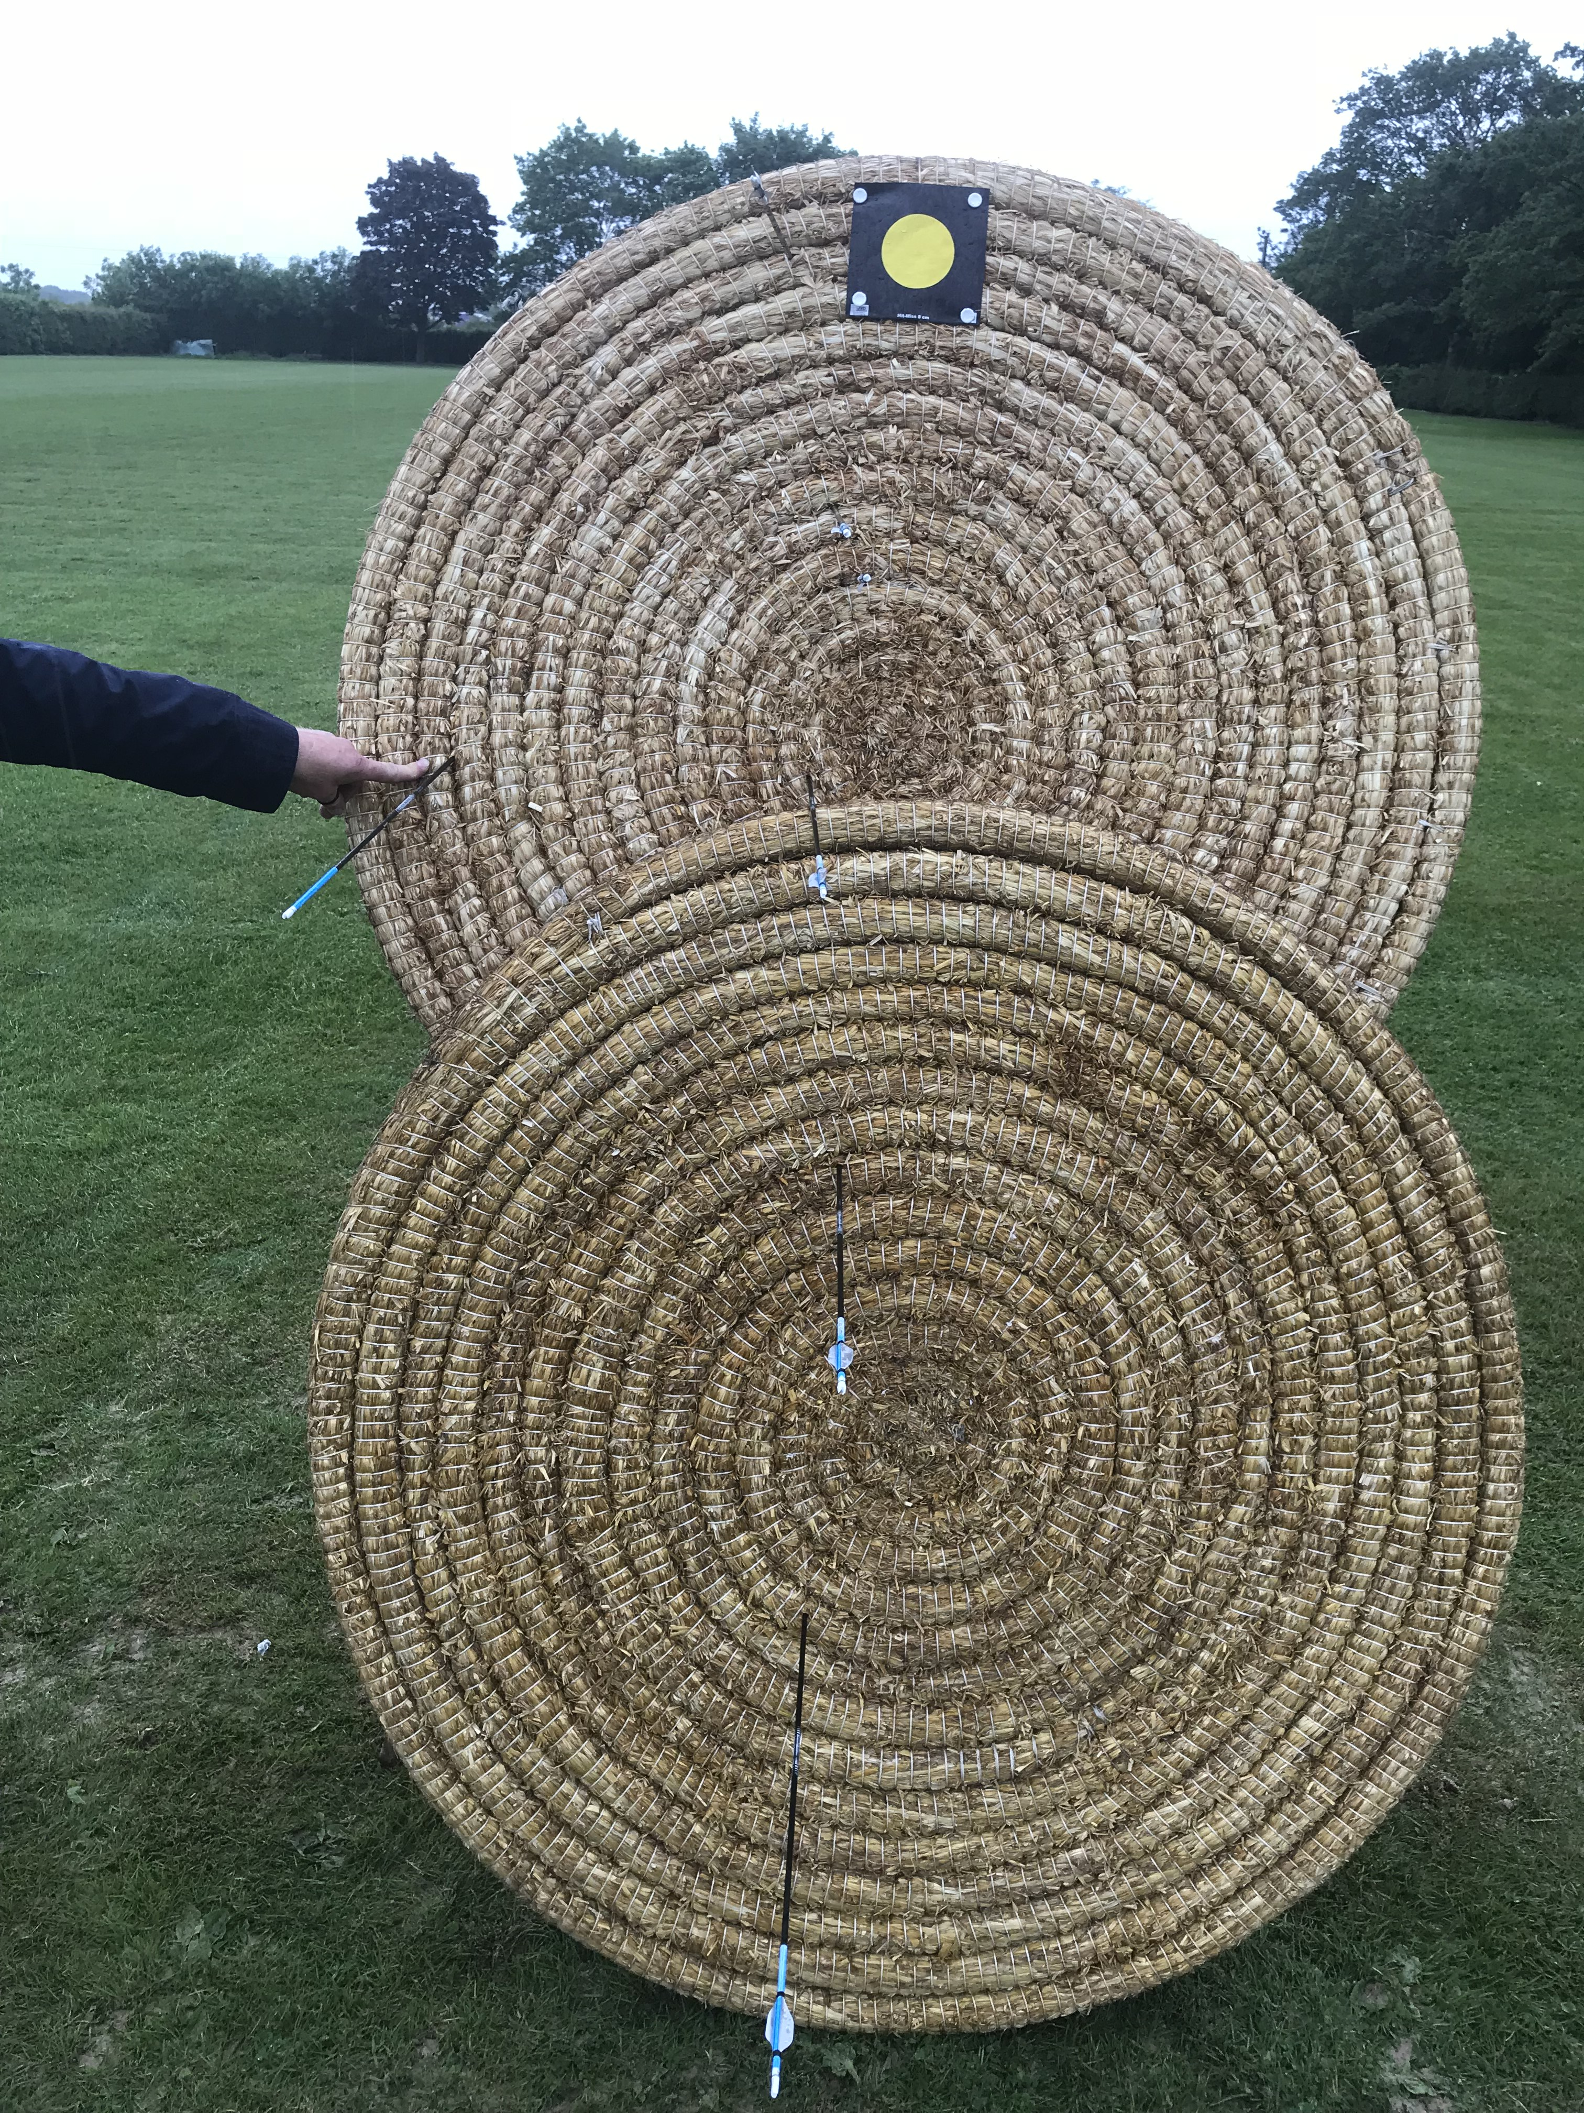
WALKBACK TUNING
1. SET OUT A TARGET WITH 2 BOSSES WITH AN AIMING SPOT AT THE TOP
2. MARK OUT SHOOTING POINTS AT 5M INTERVALS GOING AWAY FROM THE TARGET
3. THE ARCHER STARTS AT THE CLOSEST POINT AND SHOOTS AN ARROW AIMING AT THE AIM SPOT
4. THEN THE ARCHER MOVES BACK 5M AND SHOOTS AGAIN STILL AIMING AT THE AIM SPOT
5. REPEAT UNTIL THE ARROWS ARE AT THE BOTTOM

Slide 36
WALKBACK TUNING ANALYSIS

Slide 37
WALKBACK TUNING
THEN ANALYSE THE RESULTS:
5 POSSIBLE RESULTS
1. STRAIGHT LINE DOWN THE MIDDLE-CONGRATS THIS IS PERFECT!!!!!
2. STRAIGHT LINE TO THE LEFT-DECREASE SPRING TENSION
3. STRAIGHT LINE TO THE RIGHT-INCREASE SPRING TENSION
4. CURVE TO THE LEFT-MOVE THE WHOLE BUTTON INTO THE BOW
5. CURVE TO THE RIGHT-MOVE THE WHOLE BUTTON OUT

Slide 38
OTHER TUNING METHODS
We will cover these later along with compound, longbow and barebow tuning but other fine-tuning methods can be used for more experienced archers. These include:
Tiller tuning
Micro tuning-brace height, nocking point
Arrow matching
Nock Alignment
Dynamic tuning
Paper Plate tuning

Slide 39
BOW TUNED!

Slide 40
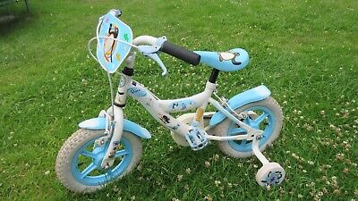
STABILISERS
WHAT IS THE MOST IMPORTANT STABILISER ON A BOW?
ANSWER: THE RISER-IT HAS THE MOST MASS AND IS THE MOST STABLE. IT IS ALSO IN THE CENTRE OF THE BOW
WHAT DO STABILISERS DO?

Slide 41
STABILISER FUNCTIONS
THREE THINGS:
1. CONTROL DISPLACEMENT- BY ADDING MASS
2. CONTROL ROTATION-BY CHANGING THE BALANCE AND REDUCING TORQUE
3. CONTROL VIBRATIONS-BY DAMPING

Slide 42
STABILISERS
TRADE OFF BETWEEN ENOUGH WEIGHT FOR THESE FUNCITONS AND THE ADDITIONAL MASS WEIGHT ON THE BOW
HEAVY WEIGHTS GIVE BETTER STABILITY BUT CAN CONTRIBUTE TO FATIGUE
THE PLACEMENT OF THE WEIGHTS, RODS ETC IS CRITICAL
THERE IS A LOT OF MATHS INVOLVED!!
BUT IT COMES DOWN TO THE FEEL OF THE SHOT
THE BLACK ART OF STABILISATION!

Slide 43
THANK YOU!!
ANY QUESTIONS?
References and Further Reading
https://www.bow-international.com/features/best-method-for-recurve-tuning/
http://www.bestrecurvebowguide.com/tuning-your-recurve-bow-part-1/
https://legendarchery.com/blogs/archery-bowhunting-blog/15692668-essential-guide-to-recurve-bow-tuning

